Slide 1
Domain Name System (DNS)
Copyright © The McGraw-Hill Companies, Inc. Permission required for reproduction or display.

Slide 2
19-1 NEED FOR DNS
TCP/IP protocols use the IP address, which uniquely identifies the connection of a host to the Internet.
People prefer to use names instead of numeric addresses.
Need a system that can map a name to an address or an address to a name.

Slide 3
Figure 19.1 Purpose of DNS
When the Internet was small, mapping was done using a host file.
The host file had only two columns: name and address.
Every host could store the host file on its disk and update it periodically from a master host file.
Today, it is impossible to have one single host file.
The host file would be too large to store in every host.
It would be impossible to update all the host files every time there is a change.

Slide 4
Figure 19.1 Purpose of DNS
One solution :
To store the entire host file in a single computer and allow access to this centralized information to every computer that needs mapping.
This would create a huge amount of traffic on the Internet.
Another solution, (used today) :
To divide this huge amount of information into smaller parts and store each part on a different computer.
The host that needs mapping can contact the closest computer holding the needed information.

Slide 5
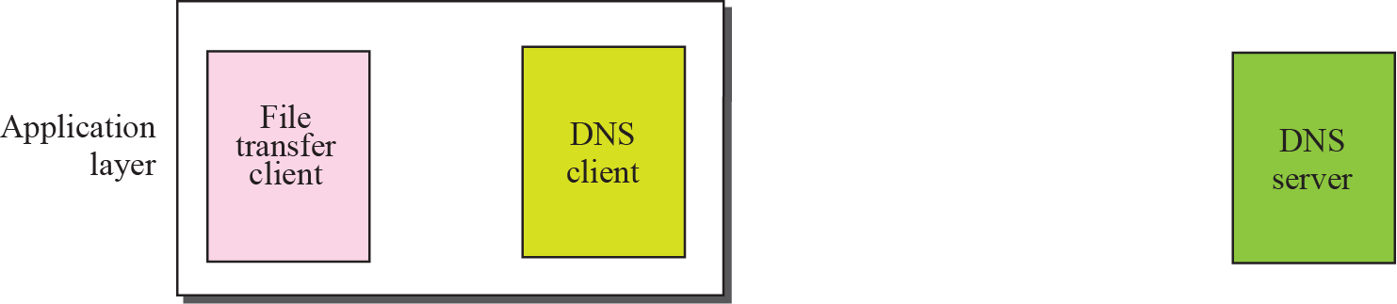
Figure 19.1 Purpose of DNS

Slide 6
Purpose of accessing Internet is to make a connection between file transfer client and server,
But before this can happen, another connection needs to be made between the DNS client and DNS server.
We need two connections;
the first is for mapping the name to an IP address;
the second is for transferring files.

Slide 7
19-2 NAME SPACE
Names assigned to machines must be carefully selected from a name space.
The names must be unique because the addresses are unique.
A name space that maps each address to a unique name can be organized in two ways: flat or hierarchical.

Slide 8
Flat Name Space
Hierarchical Name Space
Domain Name Space
Domain
Distribution of Name Space

Slide 9
Flat Name Space
In a flat name space, a name is assigned to an address.
A name in this space is a sequence of characters without structure.
Names may or may not have a common section; if they do, it has no meaning.
Disadvantage :
It cannot be used in a large system such as the Internet
it must be centrally controlled to avoid ambiguity and duplication.

Slide 10
Hierarchical Name Space
In a hierarchical name space, each name is made of several parts.
The first part can define the nature of the organization,
the second part can define the name of an organization,
the third part can define departments in the organization, and so on.
Here, the authority to assign and control the name spaces can be decentralized.
A central authority can assign the part of the name that defines the nature of the organization and the name of the organization.
The responsibility of the rest of the name can be given to the organization itself.

Slide 11
Hierarchical Name Space
Organization need not worry if the prefix chosen is taken by another organization.
Assume colleges and a company call one of their computers challenger.
college is given a name by central authority such as fhda.edu,
the company is given the name smart.com.
The end result is 3 distinguishable names:
challenger.fhda.edu,
challenger.smart.com.
Central authority controls only part of the name, not the whole.

Slide 12
Domain Name Space
To have a hierarchical name space, a domain name space was designed.
In this design names are defined in an inverted-tree structure with root at the top.
The tree can have only 128 levels: level 0 (root) to level 127 .
Label
Each node in the tree has a label, with a maximum of 63 characters.
The root label is a null string (empty string).
DNS requires that children of a node have different labels to guarantee uniqueness of the domain names.

Slide 13
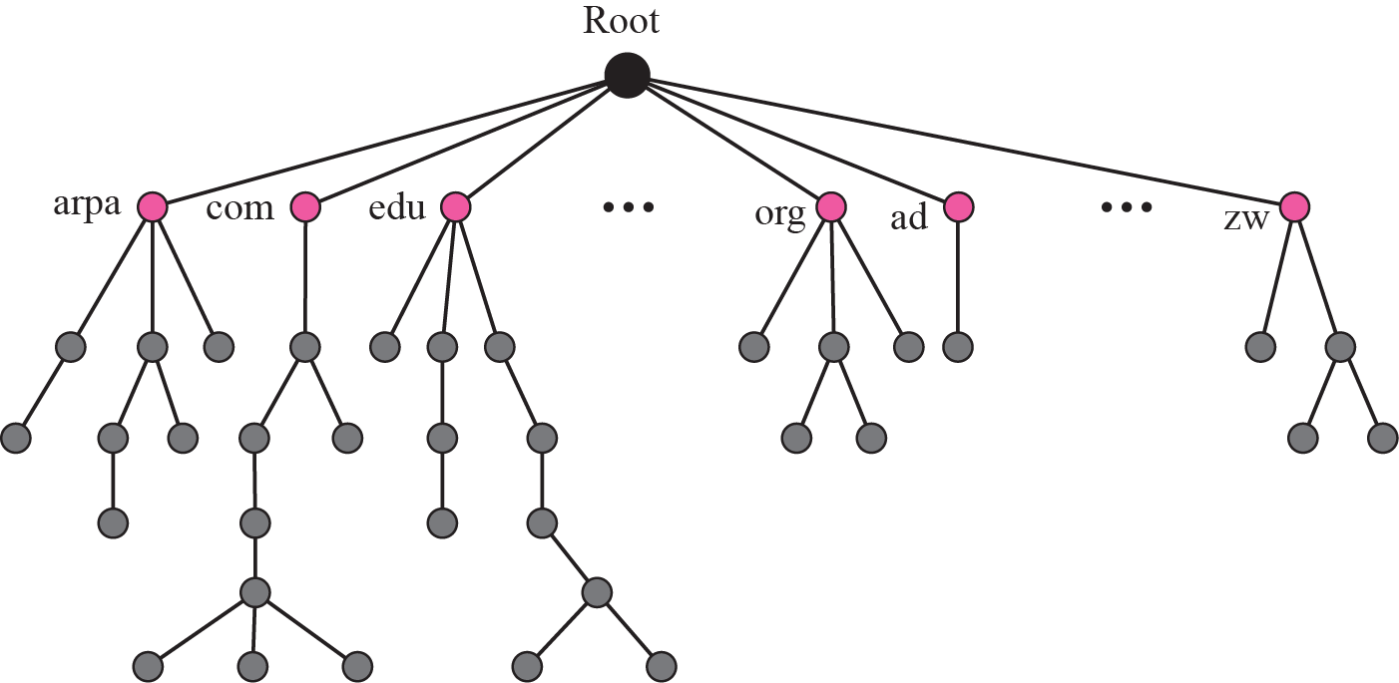
Figure 19.2 Domain name space

Slide 14
Domain Name
Each node in the tree has a domain name.
A full domain name is a sequence of labels separated by dots (.).
The domain names are always read from the node up to the root.
The last label is the label of the root (null).

Slide 15
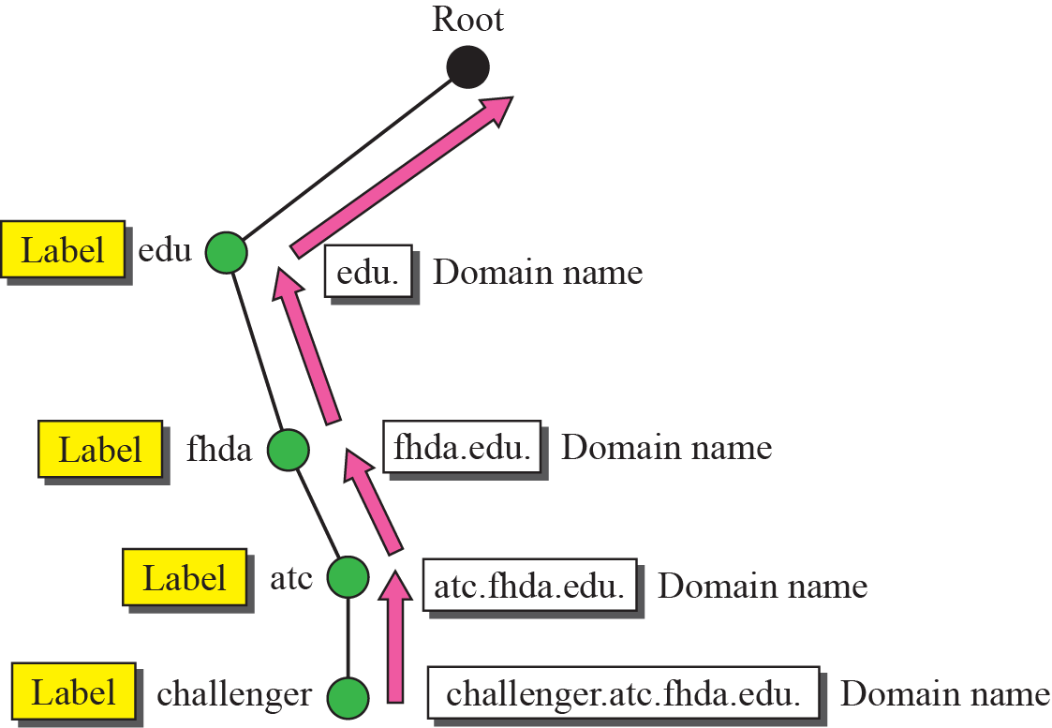
Figure 19.3 Domain names and labels
Figure 19.3 shows some domain names.

Slide 16

Fully Qualified Domain Name (FQDN)
If a label is terminated by a null string, it is called a fully qualified domain name (FQDN).
An FQDN is a domain name that contains the full name of a host.
It contains all labels, from the most specific to the most general, that uniquely define the name of the host.
A DNS server can only match an FQDN to an address.

Slide 17


Partially Qualified Domain Name (PQDN)
If a label is not terminated by a null string, it is called a partially qualified domain name (PQDN).
A PQDN starts from a node, but it does not reach the root.
Here resolver can supply the missing part, called the suffix, to create an FQDN.
If a user at the fhda.edu. site wants to get the IP address of the challenger computer, he can define the partial name
DNS client adds the suffix atc.fhda.edu. before passing address to the DNS server.
The DNS client normally holds a list of suffixes.

Slide 18
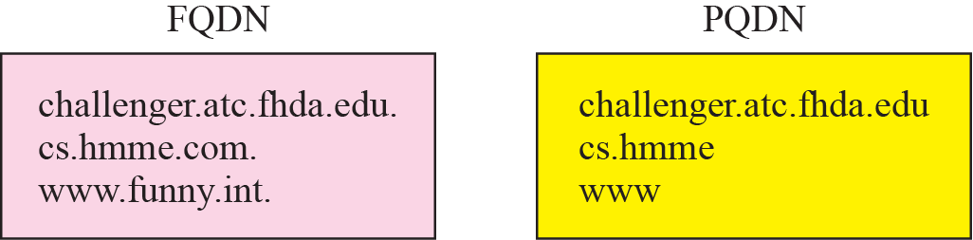
Figure 19.4 FQDN and PQDN

Slide 19
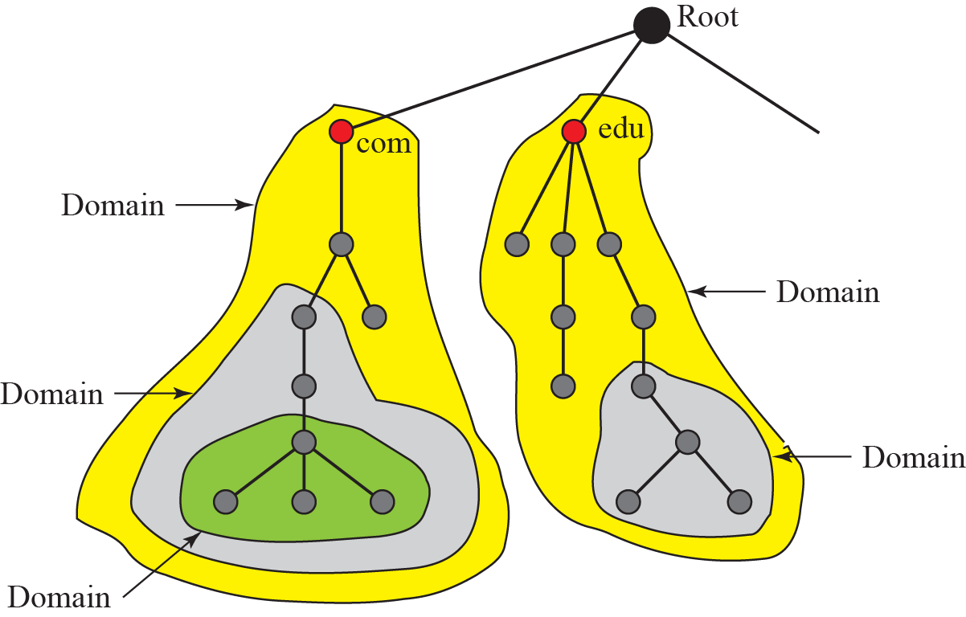
Figure 19.5 Domains
Domain
A domain is a subtree of the domain name space.
The name of the domain is the name of the node at the top of the subtree.
domain may itself be divided into domains (or subdomains ).

Slide 20
Distribution of Name Space
The information contained in the domain name space must be stored.
it is very inefficient and also not reliable to have just one computer store such a huge amount of information.
It is inefficient because responding to requests from all over the world places a heavy load on the system.
It is not reliable because any failure makes the data inaccessible.

Slide 21
Figure 19.6 Hierarchy of name servers
Hierarchy of Name Servers
Solution is to distribute information among many computers called DNS servers.
Divide the whole space into many domains based on the first level.
We let the root stand alone and create as many domains (subtrees) as there are first-level nodes.
Because a domain created this way could be very large, DNS allows domains to be divided further into smaller domains (subdomains).

Slide 22
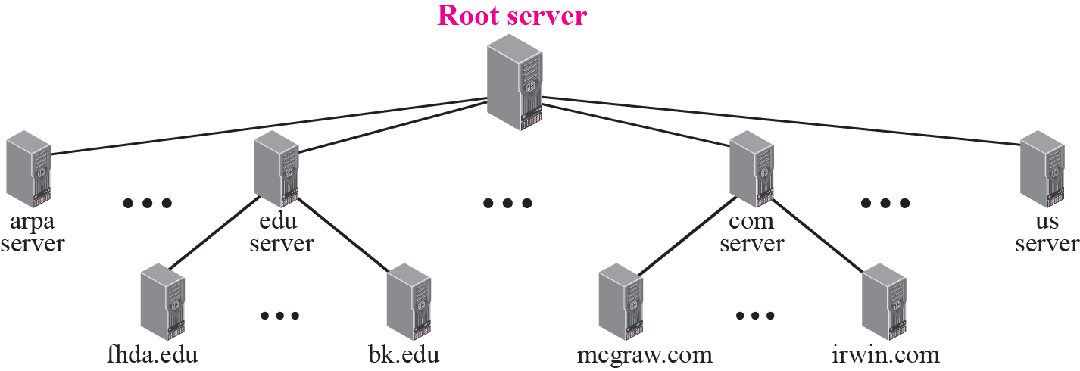
Figure 19.6 Hierarchy of name servers
In other words, we have a hierarchy of servers.

Slide 23
Figure 19.7 Zones and domains
Zone
What a server is responsible for or has authority over is called a zone.
If a server accepts responsibility for a domain and does not divide the domain into smaller domains, the “domain” and the “zone” refer to the same thing.
Server makes a database called a zone file and keeps all the information for every node under that domain.
If a server divides its domain into subdomains and delegates part of its authority to other servers, “domain” and “zone” refer to different things.
Information about nodes in the subdomains is stored in servers at the lower levels, with the original server keeping some sort of reference to these lower-level servers.

Slide 24
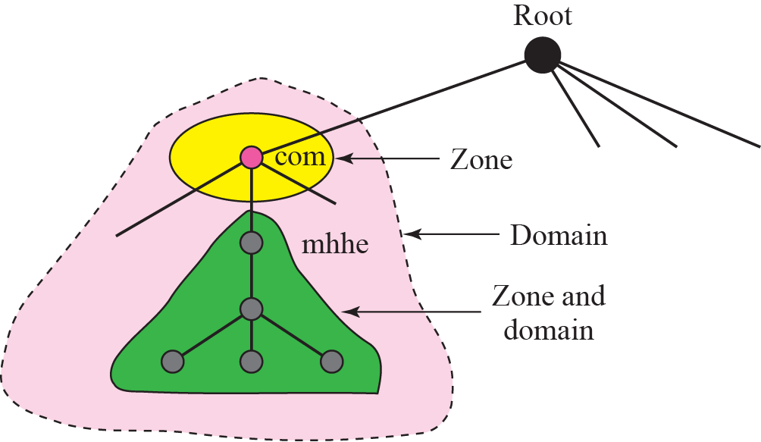
Figure 19.7 Zones and domains

Slide 25
Root Server
A root server is a server whose zone consists of the whole tree.
A root server usually does not store any information about domains but delegates its authority to other servers, keeping references to those servers.
There are several root servers, each covering the whole domain name space.
The root servers are distributed all around the world.

Slide 26
Primary and Secondary Servers
DNS defines two types of servers: primary and secondary.
A primary server is a server
Stores a file about the zone for which it is an authority.
It is responsible for creating, maintaining, and updating the zone file.
It stores the zone file on a local disk.
A secondary server is a server
Transfers the complete information about a zone from another server (primary or secondary) and stores the file on its local disk.
Secondary server neither creates nor updates the zone files.
If updating is required, it must be done by the primary server, which sends the updated version to the secondary.
Idea is to create redundancy for data so that if one server fails, other can continue serving clients.
server can be a primary server for a specific zone and a secondary server for another zone.

Slide 27

Note
A primary server loads all information from the disk file; the secondary server loads all information from the primary server. When the secondary downloads information from the primary, it is called zone transfer.

Slide 28
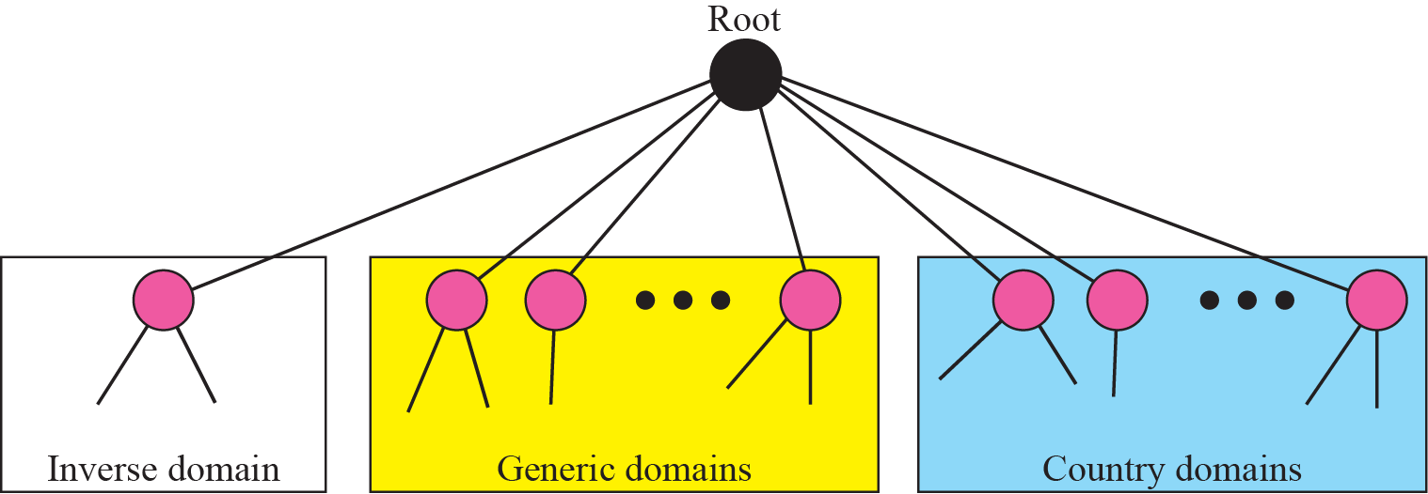
19-3 DNS IN THE INTERNET
In the Internet, the domain name space (tree) is divided into three different sections: generic domains, country domains, and the inverse domain.

Slide 29
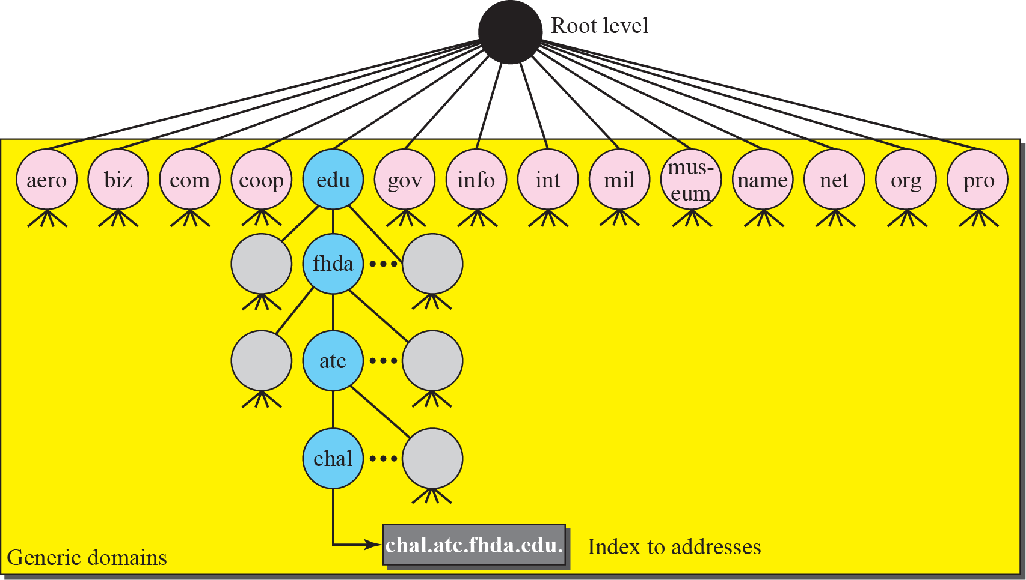
Figure 19.9 Generic domains
Generic Domains
Generic domains define registered hosts according to their generic behavior.
Looking at the tree, first level in the generic domains section allows 14 possible labels.
These labels describe the organization types as listed in Table 19.1.

Slide 30
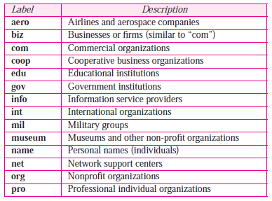
Figure 19.9 Generic domains
Generic Domains
These labels describe the organization types as listed in Table 19.1.
Table 19.1 Generic domain labels

Slide 31
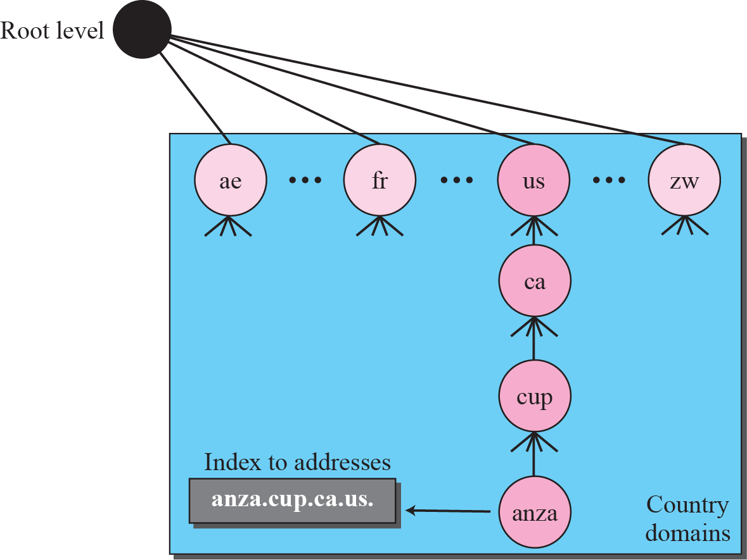
Figure 19.10 Country domains
Country Domains
Country domains uses two-character country abbreviations (us for United States).
Second labels can be organizational, or can be more specific, national designations.
Example: United States uses state abbreviations as a sub-division of us (e.g., ca.us.).
Address anza.cup.ca.us can be translated to Anza College in Cupertino in California in United States.

Slide 32
Inverse Domain
Used to map an address to a name.
This happen, when a server has received a request from a client to do a task.
The server has a file that contains a list of authorized clients, only the IP address of the client is listed.
The server asks its resolver to send a query to the DNS server to map an address to a name to determine if the client is on the authorized list.
This type of query is called an inverse or pointer (PTR) query.
To handle a pointer query, inverse domain is added to the domain name space with the first-level node called arpa.
second level is also one single node named in-addr (for inverse address).
The rest of the domain defines IP addresses.

Slide 33
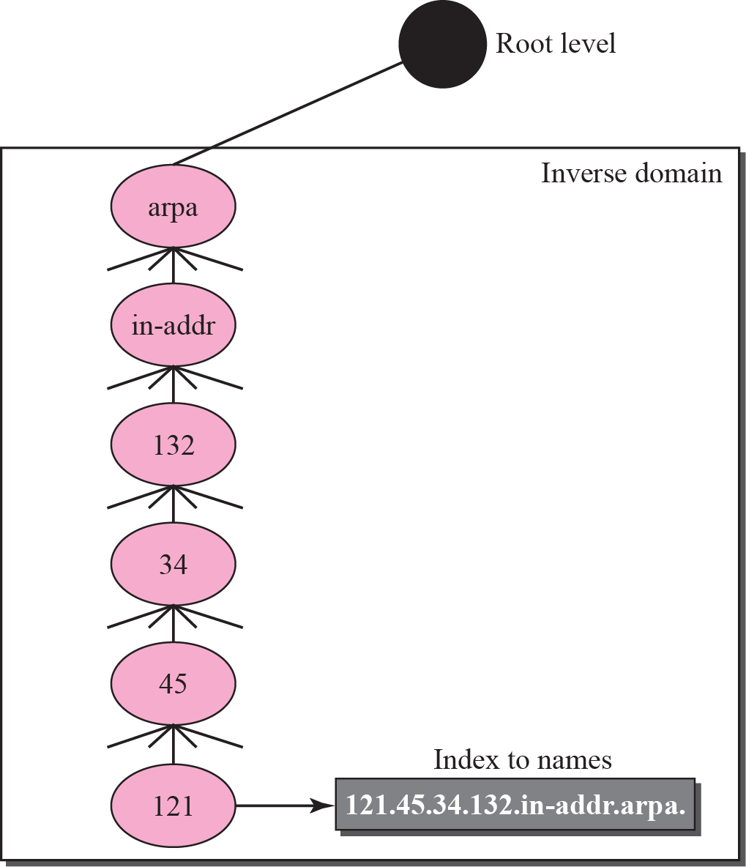
Figure 19.11 Inverse domain
Inverse Domain
The servers that handle the inverse domain are also hierarchical.
This means the netid part of the address should be at a higher level than the subnetid part, and the subnetid part higher than the hostid part.
IP address such as 132.34.45.121 is read as 121.45.34.132.in-addr. arpa.

Slide 34
Registrar
How are the new domains added to DNS?
This is done through a registrar, a commercial entity accredited by ICANN.
A registrar first verifies that the requested domain name is unique and then enters it into the DNS database.
A fee is charged.

Slide 35
19-4 RESOLUTION
Mapping a name to an address or an address to a name is called name-address resolution.

Slide 36
Resolver
Mapping Names to Addresses
Mapping Addresses to Names
Recursive Resolution
Iterative Resolution
Caching

Slide 37
Resolver
DNS is designed as a client-server application.
A host that needs to map an address to a name or a name to an address calls a DNS client called a resolver.
The resolver accesses the closest DNS server with a mapping request.
If the server has the information, it satisfies the resolver; otherwise, it either refers the resolver to other servers or asks other servers to provide the information.
After the resolver receives the mapping, it interprets the response to see if it is a real resolution or an error, and finally delivers the result to the process that requested it.

Slide 38
Mapping Names to Addresses
Resolver gives a domain name to the server and asks for corresponding address.
In this case, server checks the generic domains or country domains to find the mapping.
If the domain name is from the generic domains section, the resolver receives a domain name such as “chal.atc.fhda.edu.”.
The query is sent by the resolver to the local DNS server for resolution.
If the local server cannot resolve the query, it either refers the resolver to other servers or asks other servers directly.
If the domain name is from the country domains section, the resolver receives a domain name such as “ch.fhda.cu.ca.us.”. The procedure is the same.

Slide 39
Mapping Addresses to Names
A client can send an IP address to a server to be mapped to a domain name.
this is called a PTR query.
To answer queries of this kind, DNS uses the inverse domain.
In the request, the IP address is reversed and two labels, in-addr and arpa, are appended to create a domain acceptable by the inverse domain section.
If the resolver receives the IP address 132.34.45.121, resolver first inverts the address and then adds the two labels before sending.
The domain name sent is “121.45.34.132.in-addr.arpa.”, which is received by the local DNS and resolved.

Slide 40
Recursive Resolution
The client (resolver) can ask for a recursive answer from a name server.
This means that the resolver expects the server to supply the final answer.
If the server is the authority for the domain name, it checks its database and responds.
If the server is not the authority, it sends the request to another server (the parent usually) and waits for the response.
If the parent is the authority, it responds; otherwise, it sends the query to yet another server.
When the query is finally resolved, the response travels back until it finally reaches the requesting client.

Slide 41
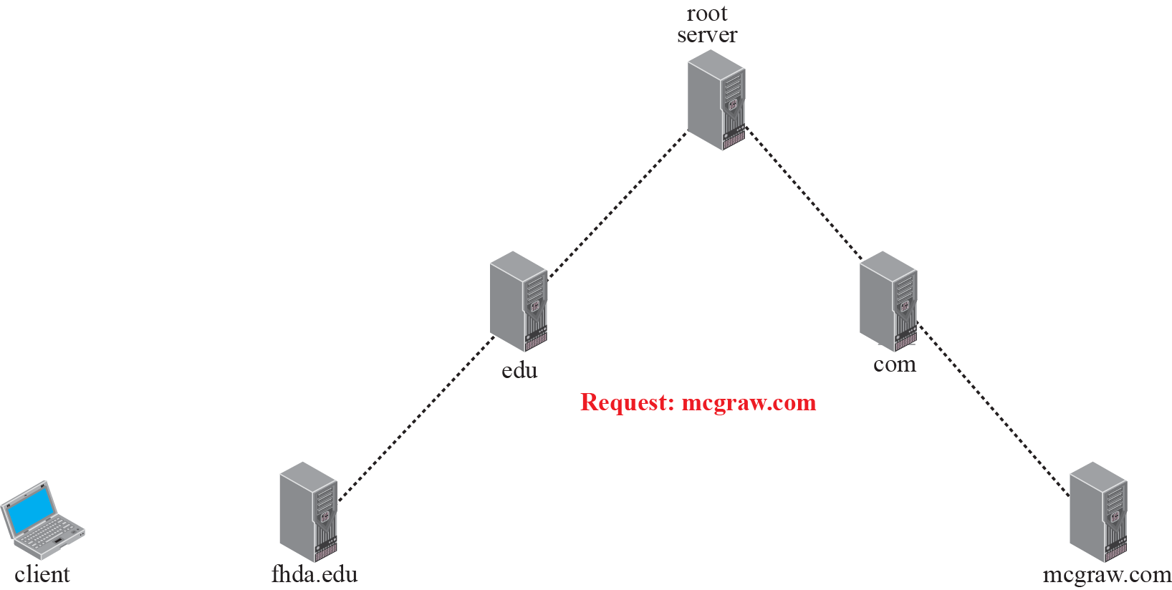
Figure 19.12 Recursive resolution

Slide 42
Iterative Resolution
If the server is an authority for the name, it sends the answer.
If it is not, it returns (to the client) the IP address of the server that it thinks can resolve the query.
The client is responsible for repeating the query to this second server.
If the newly addressed server can resolve the problem, it answers the query with the IP address; otherwise, it returns the IP address of a new server to the client.
Now the client must repeat the query to the third server. This process is called iterative because the client repeats the same query to multiple servers.
In Figure 19.13 client queries 5 servers before it gets an answer from mcgraw.com server.

Slide 43
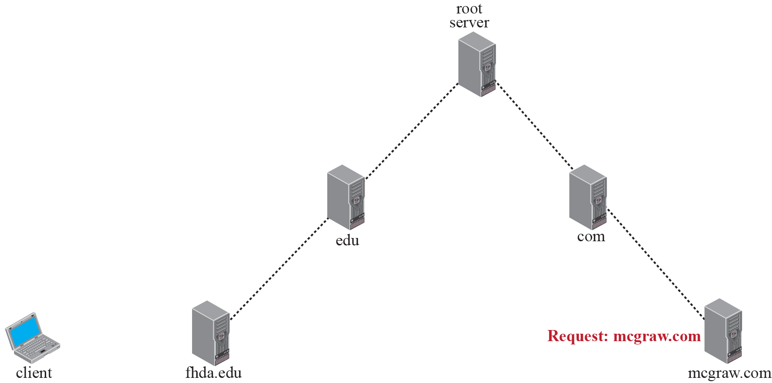
Figure 19.13 Iterative resolution

Slide 44
Caching
Each time a server receives a query for a name that is not in its domain, it needs to search its database for a server IP address.
Reduction of this search time would increase efficiency.
DNS handles this with a mechanism called caching.
When a server asks for a mapping from another server and receives the response, it stores this information in its cache memory before sending it to the client.
If the same or another client asks for the same mapping, it can check its cache memory and resolve the problem.
However, to inform the client that the response is coming from the cache memory and not from an authoritative source, the server marks the response as unauthoritative.

Slide 45
Caching (contd)
Caching speeds up resolution, but it can also be problematic.
If a server caches a mapping for a long time, it may send an outdated mapping to client.
To counter this, two techniques are used.
First, authoritative server always adds information to the mapping called time-to-live (TTL).
It defines the time in seconds that the receiving server can cache the information.
After that time, mapping is invalid and any query must be sent again to authoritative server.
Second, DNS requires that each server keep a TTL counter for each mapping it caches.
Cache memory must be searched periodically and those mappings with an expired TTL must be purged.

Slide 46
19-5 DNS MESSAGES
DNS has two types of messages: query and response.
Both types have the same format.
Query message consists of a header and
question records;
Response message consists of a
header,
question records,
answer records,
authoritative records, and
additional records.

Slide 47
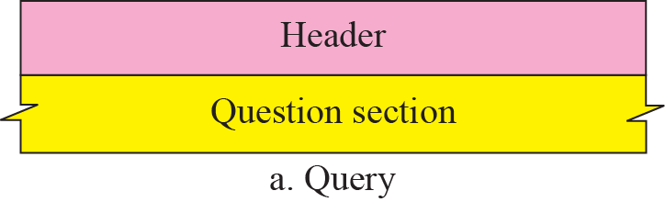
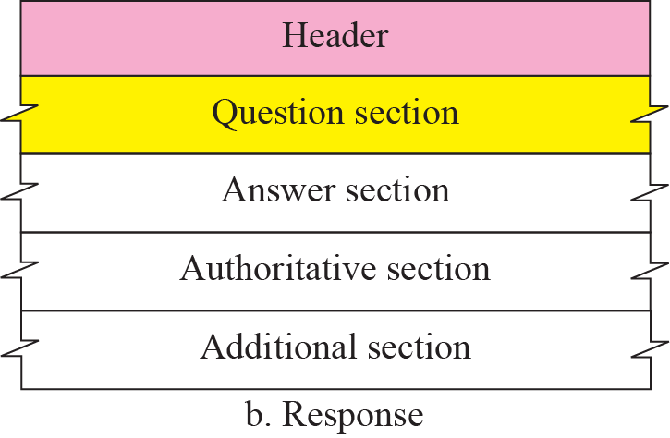
Figure 19.14 Query and response messages

Slide 48
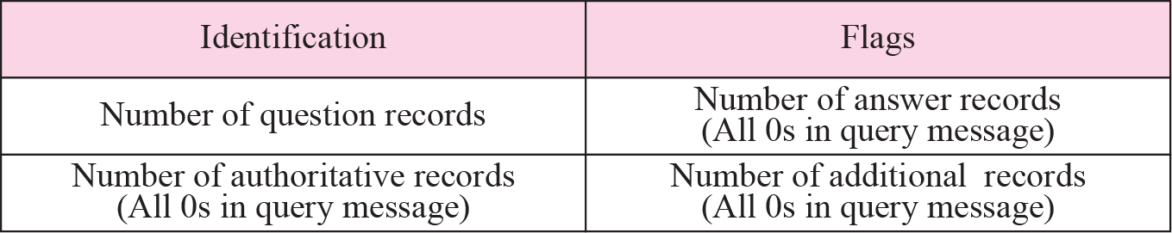
Figure 19.15 Header format
Header
Both query and response messages have the same header format with some fields set to zero for the query messages.
Header is 12 bytes and header fields are as follows
Identification.
16-bit field used by the client to match the response with the query.
client uses a different identification number each time it sends a query.
server duplicates this number in the corresponding response.

Slide 49
Figure 19.16 Flags field
Flags. 16-bit field consisting of the subfields
QR (query/response). defines type of message. 0 – query, 1- response.
OpCode. 4-bit defines type of query or response (0-standard, 1 - inverse, and 2 -server status request).
AA (authoritative answer). value 1 means that the name server is an authoritative server. used only in a response message.
TC (truncated). value 1 means that response was more than 512 bytes and truncated to 512. used when DNS uses the services of UDP.
RD (recursion desired). value 1 means client desires a recursive answer. It is set in the query message and repeated in the response message.
RA (recursion available). When it is set in the response, it means that a recursive response is available. It is set only in the response message.
Reserved. This is a 3-bit subfield set to 000.

Slide 50
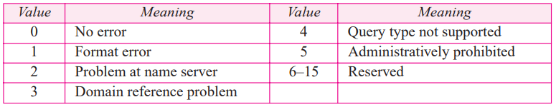
Figure 19.15 Header format
rCode. 4-bit field shows the status of the error in the response. only an authoritative server can make such a judgment.
Table shows the possible values for this field.

Slide 51
Header field
Number of question records. 16-bit field containing the number of queries in the question section of the message.
Number of answer records. 16-bit field containing the number of answer records in the answer section of the response message. Its value is zero in the query message.
Number of authoritative records. 16-bit field containing number of authoritative records in the authoritative section of a response message. value is zero in the query message.
Number of additional records. 16-bit field containing the number of additional records in the additional section of a response message. value is zero in the query message.

Slide 52
Question Section Consisting of one or more question records. present on both query and response messages.
Answer Section
Consisting of one or more resource records.
present only on response messages.
This section includes the answer from the server to the client (resolver).
Authoritative Section
Consisting of one or more resource records.
present only on response messages.
gives information (domain name) about one or more authoritative servers for the query.
Additional Information Section
Consisting of one or more resource records. present only on response messages.
Provides additional information to help the resolver.
server may give domain name of an authoritative server to the resolver in the authoritative section, and include IP address of same authoritative server in additional information section.

Slide 53
19-6 TYPES OF RECORDS
Two types of records are used in DNS.
Question records are used in question section of the query and response messages.
Resource records are used in answer, authoritative, and additional information sections of the response message.

Slide 54
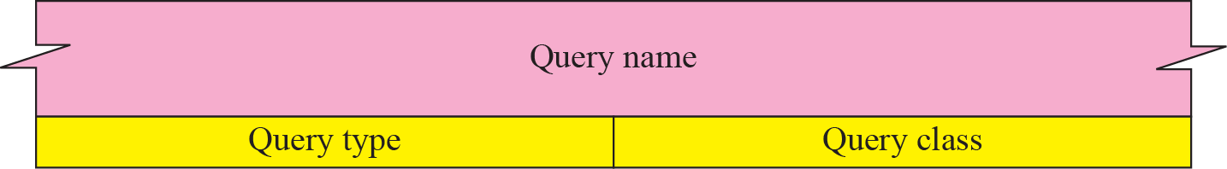
Figure 19.17 Question record format
Question Record
A question record is used by the client to get information from a server.
This contains the domain name.
Figure shows the format of a question record.
Query name. variable-length field containing a domain name. Count field refers to number of characters in each section.

Slide 55
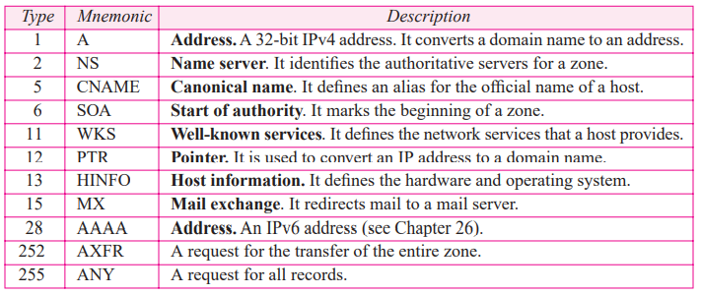
Query type. 16-bit field defining the type of query.
Table shows some of the types commonly used.

Slide 56
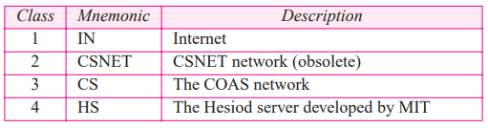
Query class. 16-bit field defining the specific protocol using DNS.
Table shows the current values.
Here we are interested only in class 1 (the Internet).

Slide 57
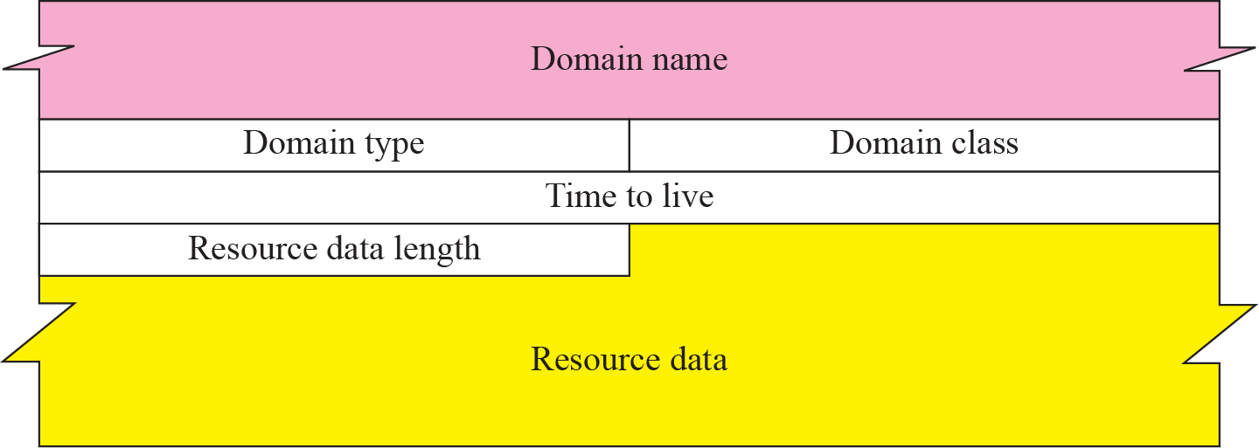
Resource Record
Each domain name (each node on the tree) is associated with a record called the resource record.
The server database consists of resource records.
Resource records are also what is returned by the server to the client.
Figure shows the format of a resource record.

Slide 58
Figure 19.19 Resource record format
Domain name. Variable-length field containing the domain name. It is a duplication of the domain name in the question record. Since DNS requires the use of compression everywhere a name is repeated, this field is a pointer offset to the corresponding domain name field in the question record.
Domain type. same as query type field in the question record except last two types are not allowed.
Domain class. same as the query class field in the question record.
Time-to-live. 32-bit field defines the number of seconds the answer is valid. The receiver can cache the answer for this period of time. A zero value means that the resource record is used only in a single transaction and is not cached.

Slide 59
Resource data length. 16-bit field defining the length of the resource data.
Resource data. Variable-length field containing the answer to the query (in answer section) or the domain name of the authoritative server (in authoritative section) or additional information (in additional information section). Format and contents of this field depend on value of the type field.

Slide 60
19-7 COMPRESSION
DNS requires that a domain name be replaced by an offset pointer if it is repeated.
For example, in a resource record the domain name is usually a repetition of the domain name in the question record.
For efficiency, DNS defines a 2-byte offset pointer that points to a previous occurrence of the domain or part of it.
The format of the field is shown in Figure 19.20.

Slide 61
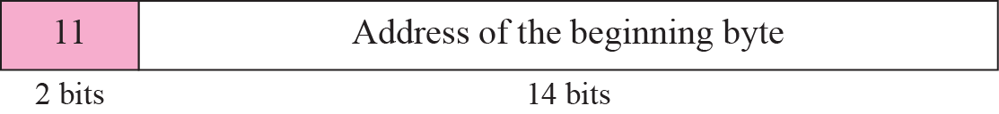
Figure 19.20 Format of an offset pointer
First 2 high-order bits are two 1s to distinguish an offset pointer from a length field.
Other 14 bits represent a number that points to corresponding byte number in the message.
Bytes in a message are counted from beginning of message with first byte counted as byte 0.
If an offset pointer refers to byte 12 (13th byte) of message, the value should be 1100000000001100.

Slide 62
Example 19.1
A resolver sends a query message to a local server to find the IP address for the host “chal.fhda.edu.”.
Write the query and response message.
Write the flag fields
Assume : in query : recursive query expected.
in response : recursive is available.

Slide 63
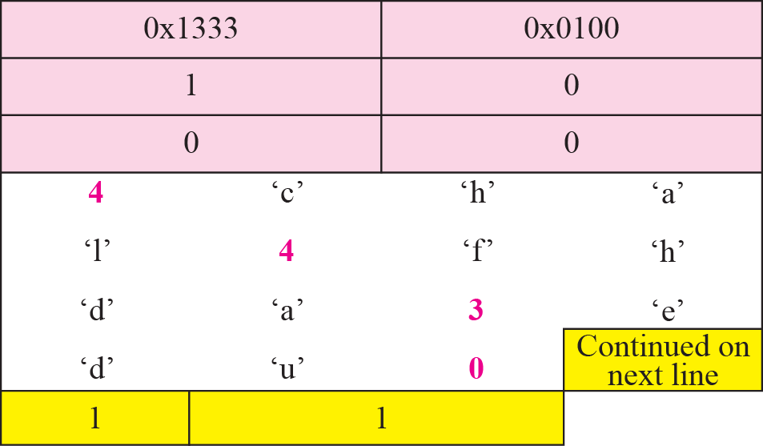
Example 19.1
A resolver sends a query message to a local server to find the IP address for the host “chal.fhda.edu.”.
Here discuss the query and response messages separately.
Figure 19.21 shows the query message sent by the resolver.
The first 2 bytes show the identifier (1333)₁₆. It is used as a sequence number and relates a response to a query.

Slide 64
Example 19.1
The next bytes contain the flags with the value of 0x0100 in hexadecimal.
In binary it is 0000000100000000 as shown below:
The QR bit defines the message as a query.
The OpCode is 0000, which defines a standard query.
The recursion desired (RD) bit is set.
The message contains only one question record.
The domain name is 4chal4fhda3edu0.
The next 2 bytes define the query type as an IP address;
the last 2 bytes define the class as the Internet

Slide 65
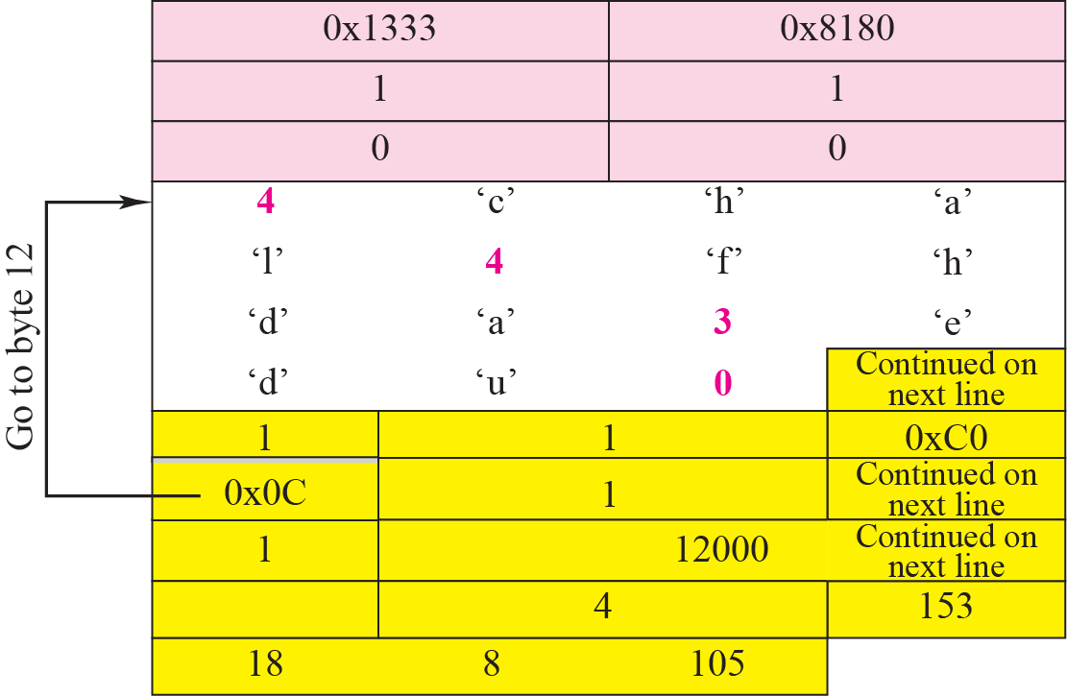
Example 19.1 Continued
Figure 19.22 shows the response of the server.
response is similar to query except that flags are different and number of answer records is one.

Slide 66
Example 19.1 Continued
The flags value is 0x8180 in hexadecimal. In binary it is 1000000110000000
QR bit defines the message as a response.
The OpCode is 0000, which defines a standard response.
The recursion available (RA) and RD bits are set.
The message contains one question record and one answer record.
The question record is repeated from the query message.
The answer record has a value of 0xC00C (split in two lines), which points to the question record instead of repeating the domain name.
The next field defines the domain type (address).
The field after that defines the class (Internet).
The field with the value 12,000 is the TTL (12,000 s).
The next field is the length of the resource data, which is an IP address (153.18.8.105).

Slide 67
Example 19.2
An FTP server has received a packet from an FTP client with IP address 153.2.7.9.
The FTP server wants to verify that the FTP client is an authorized client.
The FTP server can consult a file containing the list of authorized clients. However, the file consists only of domain names.
The FTP server has only the IP address of the requesting client, which was the source IP address in the received IP datagram.
The FTP server asks the resolver (DNS client) to send an inverse query to a DNS server to ask for the name of the FTP client.
Discuss the query and response messages separately.

Slide 68
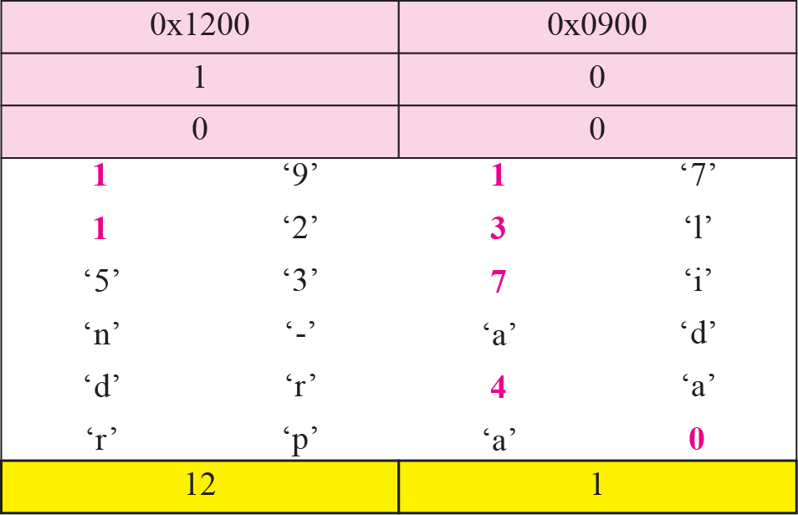
Figure 19.23 Example 19.2: Inverse query message
Figure 19.23 shows the query message sent from the resolver to the server.
The first 2 bytes show the identifier (0x1200).

Slide 69
Example 19.2 Continued
The flags value is 0x0900 in hexadecimal. In binary it is 0000100100000000
The OpCode is 0001, which defines an inverse query.
The message contains only one question record.
The domain name is 19171231537in-addr4arpa.
The next 2 bytes define the query type as PTR
the last 2 bytes define the class as the Internet.
IP address 153.2.7.9

Slide 70
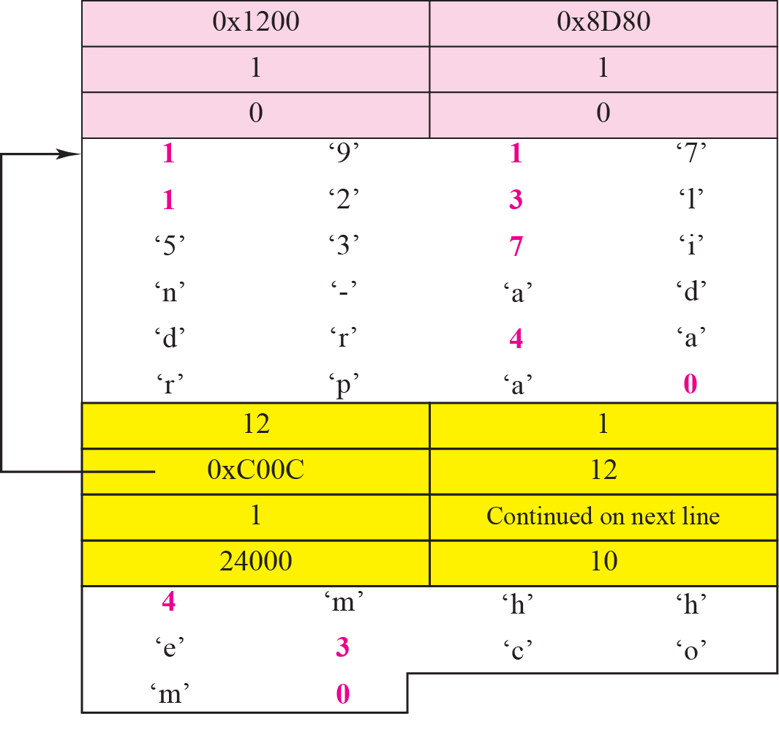
Figure 19.24 Example 19.2: Inverse response message
Figure 19.24 shows the response.

Slide 71
Example 19.2 Continued
The flags value is 0x8D80 in hexadecimal. In binary it is 1000110110000000
The message contains one question record and one answer record.
The question record is repeated from the query message.
The answer record has a value of 0xC00C, which points to the question record instead of repeating the domain name.
The next field defines the domain type (PTR).
The field after that defines the class (Internet), and the field after that defines the TTL (24,000 s).
The next field is the length of the resource data (10). The last field is the domain name 4mhhe3com0, which means “mhhe.com.”.

Slide 72
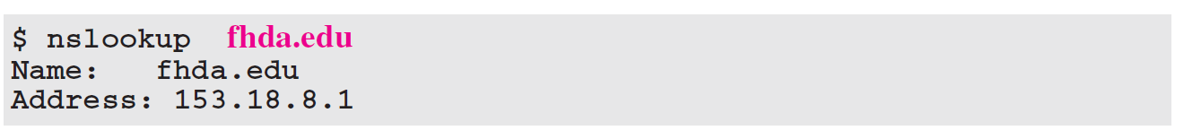
Example 19.3
In UNIX and Windows, the nslookup utility can be used to retrieve address/name mapping. The following shows how we can retrieve an address when the domain name is given.
The nslookup utility can also be used to retrieve the domain name when the address is given as shown below:

Slide 73
END

